Slide 1
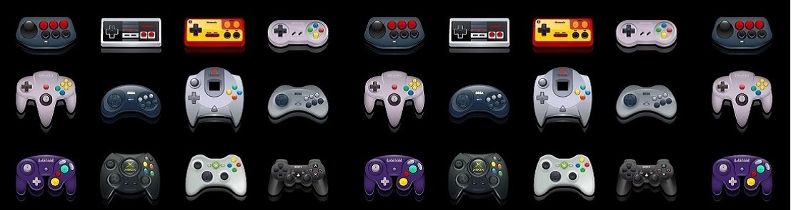
Are You The Average Gamer?
Group 9
Team Members:
Emeka Obianyor
Kiran Mundae
Charles Robinson
Nick Orewiler
Sadie Barnett-Boudreau

Slide 2




Group 5 Team Members
Sadie Barnett-Boudreau
Michael Bien
Jennifer Darby

Slide 3
General Premise:
Gamer’s visit the site to see how they measure up with gamers in other countries
The gamer is presented with an entry panel, a map and three charts: Gaming Revenue by Country, Average Weekly Hours Played by Country and Average Weekly Hours Played by Age Group
When the gamer enters their information, the charts are updated with red bars to indicate the category that they fall into. Note: The country is obtained through a scrape of the user’s IP address
The map would populate the gamer’s location with a pin

Slide 4
Data & Limitations:
We searched for a free source of raw gamer data but one was not available (Statista offers raw data for a $468 annual fee)
We resorted to locating aggregated data sources and found the following:
https://financesonline.com/number-of-gamers-worldwide/
https://www.limelight.com/resources/white-paper/state-of-online-gaming-2019/#appendix
https://steamdb.info/app/753/graphs/
These aggregated data sources made it impossible to draw analytical conclusions from the data

Slide 5



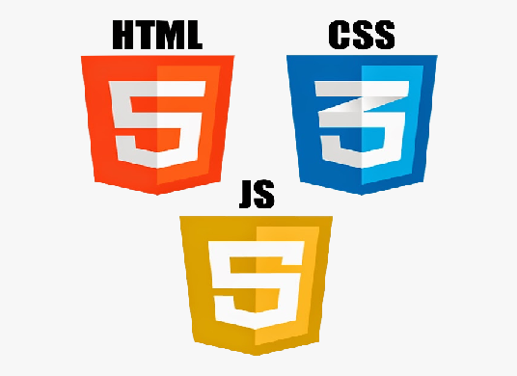


Data Flow & Architecture:
ERD
revenue
country VARCHAR(30) NOT NULL
revenue INTEGER NOT NULL
gamers INTEGER NOT NULL
steam_users_lifetime
date DATE NOT NULL,
users INTEGER NOT NULL
in_game INTEGER NOT NULL
hours_average_country
Country VARCHAR(30) NOT NULL
avg_hours FLOAT NOT NULL
age
age VARCHAR(30) NOT NULL,
avg_hours INTEGER NOT NULL
top_ten
date DATE NOT NULL
dota_2 INTEGER NOT NULL
counter_strike INTEGER NOT NULL
terraria INTEGER NOT NULL
postal INTEGER NOT NULL
gta INTEGER NOT NULL
fallout_4 INTEGER NOT NULL
life_is_strange INTEGER NOT NULL
battlegrounds INTEGER NOT NULL
hitman_2 INTEGER NOT NULL
among_us INTEGER NOT NULL
country_hours
country VARCHAR(30) NOT NULL avg_hours INTEGER NOT NULL latlng VARCHAR NOT NULL

Slide 6
Steps to Recreate the Project Locally:
Open PostgreSQL and create a database called Gamers
2. Use the postgres_create_table_script.txt file to create the necessary tables in Postgres
3. Open the Project_2_flask.py file and update the Postgres password on line 28 to your own
4. Run the Project_2_flask.py file to start the flask server

Slide 7
Any Questions?

